Slide 1
Biological variability, technical artifacts
and reproducibility in the study of the microbiome
Anthony Fodor
UNC Charlotte
Bioinformatics and Genomics

Slide 2
Reproducibility is enabled when there is a consistent signal
that is larger than measurement error and biological variability
Assertion #1: We are making reasonable progress towards technical reproducibility
but interactions between different pipeline components limit how much we can completely eliminate bias.
Assertion #2: Stochasticity, biological noise and small effect sizes are primary
drivers of lack of reproducibility in the current metagenomics literature

Slide 3
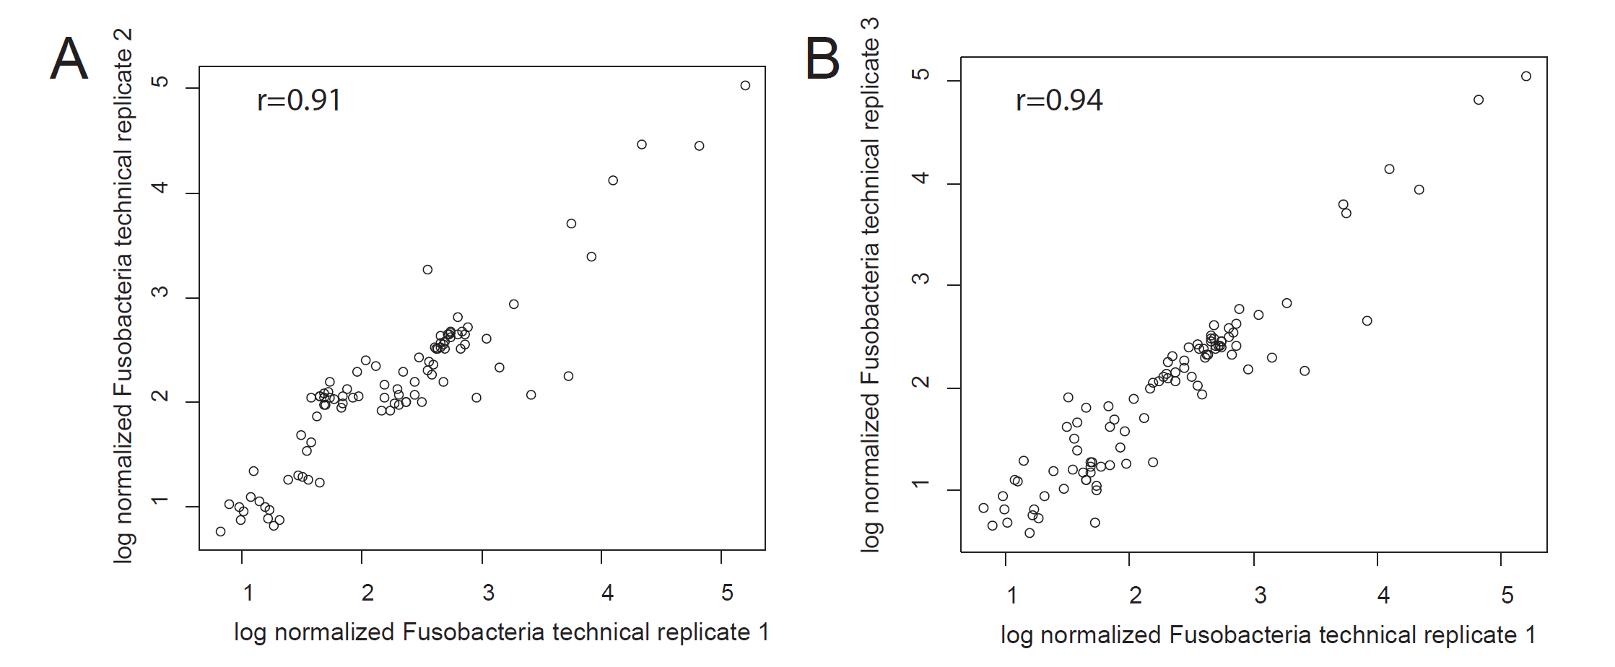
Within a pipeline, PCR and extraction steps can be highly replicable
Rifaximin Treatment is Associated With Small, Transient Decreases in Multiple Taxa in the Human Gut Microbial Community. Fodor et al. In revision, gut

Slide 4
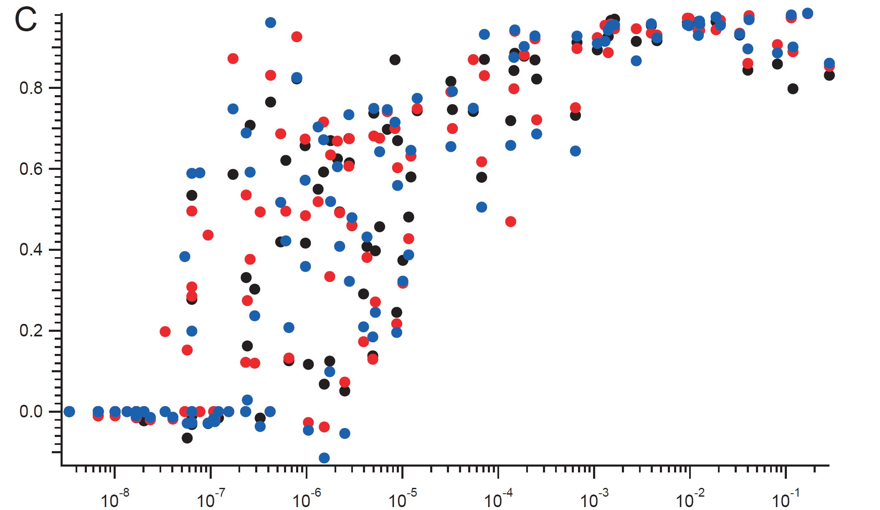
It is harder to measure a reproducible signal on low-abundance taxa
.8
Correlation Coefficient
.6
.4
.2
.0
10⁻⁸
10⁻⁷
10⁻⁶
10⁻⁵
10⁻⁴
10⁻³
10⁻²
10⁻¹
Relative Abundance

Slide 5
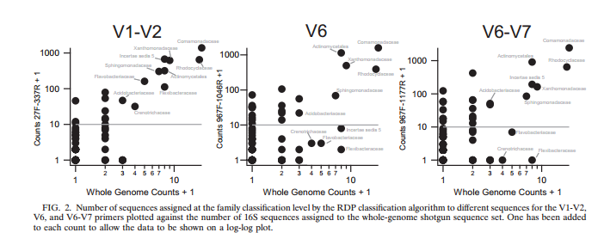
Whole genome and PCR based 16S rRNA tend to agree on prevalent taxa but disagree on rare taxa
Hamp et al. – 2009 - Effects of Experimental Choices and Analysis Noise on Surveys of the “Rare Biosphere” - AEM

Slide 6
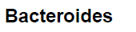
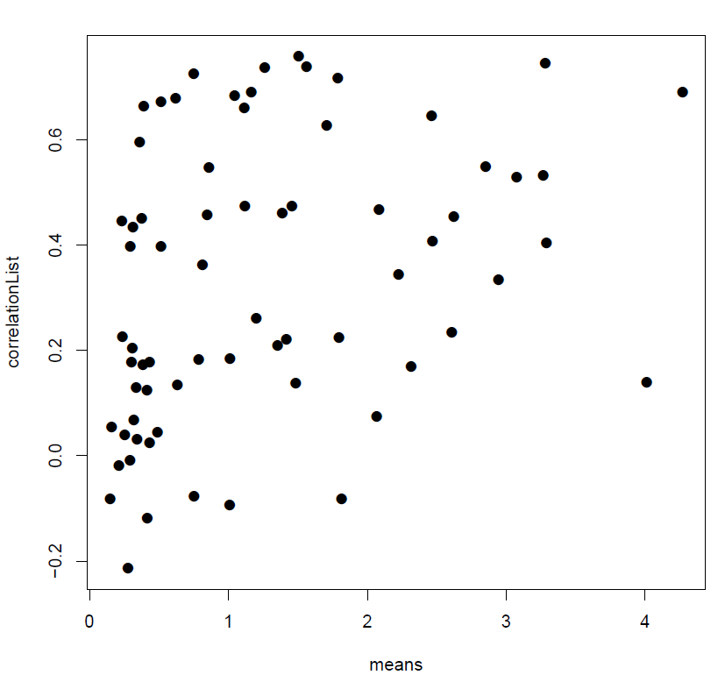
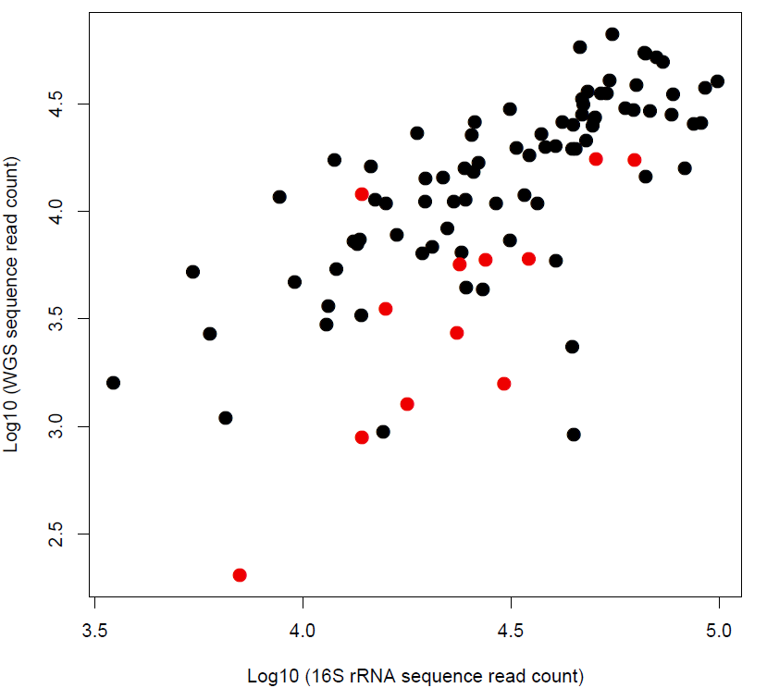
It is harder to measure a reproducible signal on low-abundance taxa
Bacteroides
Log 10 ( WGS counts)
Correlation Coefficient
Unclassified
Log 10 ( 16S rRNA counts )
mean Log 10 ( average # of reads)
Log
Inter-niche and inter-individual variation in gut microbial community assessment using stool, rectal swab, and mucosal samples. Roshonda B. Jones, Xiangzhu Zhu, Emily Moan, Harvey J. Murff, Reid M. Ness, Douglas L. Seidner, Chang Yu, Qi Dai, Anthony A. Fodor, M. Andrea Azcarate-Peril, Martha J. Shrubsole (in preperation)

Slide 7
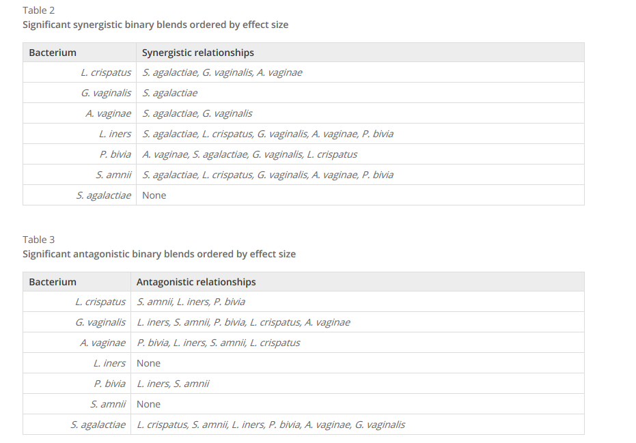
Interactions between bacteria can complicate attempts to correct for bias in each step of a pipeline
Brooks et al . The truth about metagenomics: quantifying and counteracting bias in 16S rRNA studies. BMC Microbiology2015

Slide 8
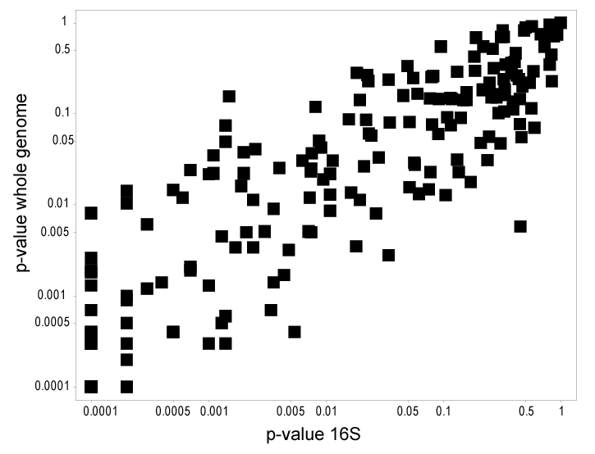
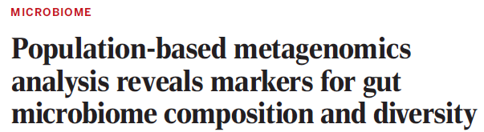
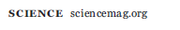
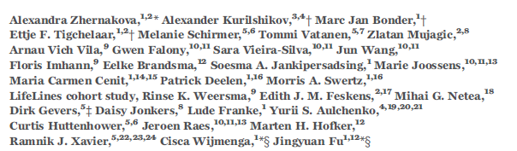
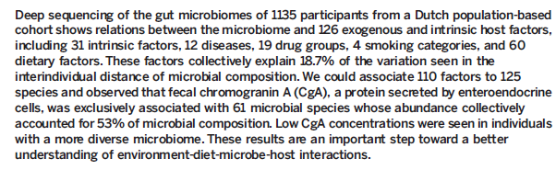
Within a pipeline, inference performed on WGS and 16S can produce very similar results
Supplementary table 7

Slide 9
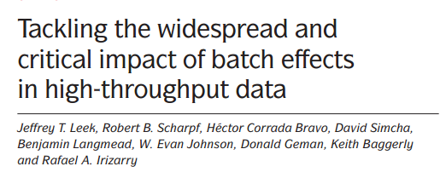
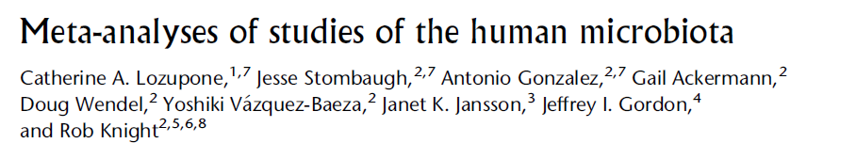
Batch effects have long been known to be potential drivers of artifacts of all genomics experiments

Slide 10
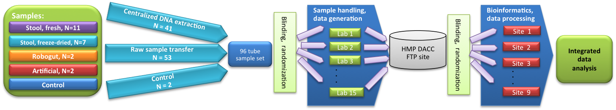
Pipeline optimization can yield different results on different samples
MBQC Study design

Slide 11
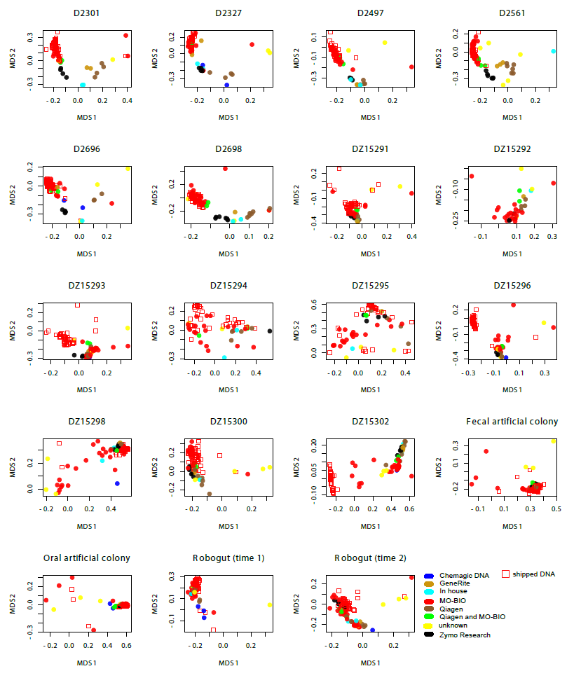
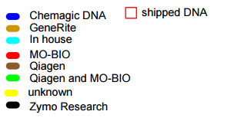
Do different labs using the same extraction kit get the same results?
Notes:
Graph shows multi-dimensional scaling plots (similar to PCA plots) for all samples from all labs used in MBQC study. The graph is for only one bioinformatics pipeline. The different colors are for extraction kits. Square shape is for DNA extracted at central lab.
Overall, however, our data are consistent with kit manufacturer introducing systematic bias – e.g., Mo-Bio in red are all superimposed.

Slide 12
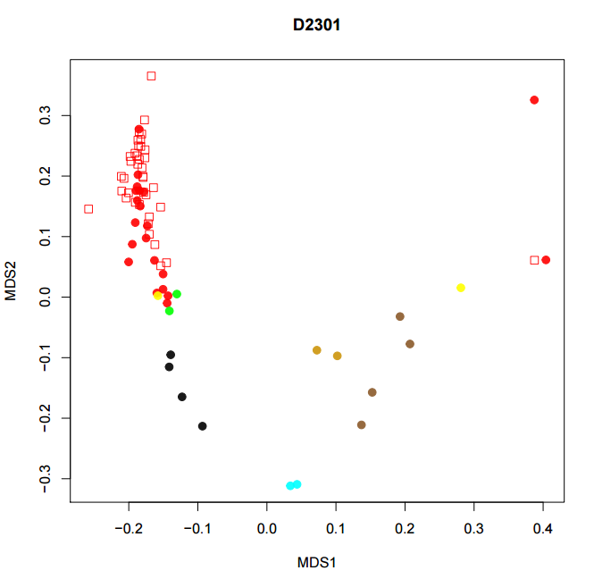
Extraction kit explains a good deal of the
overall variation for many samples…

Slide 13
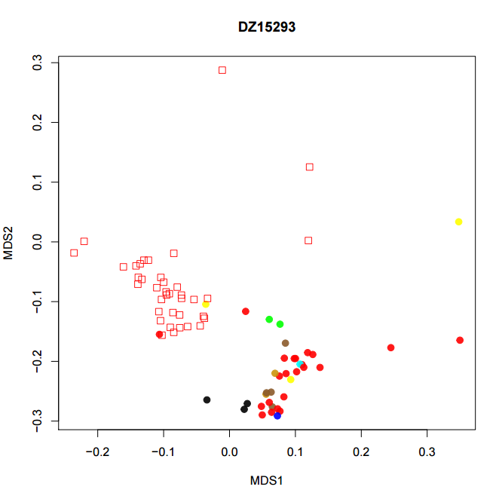
But not for every sample…

Slide 14
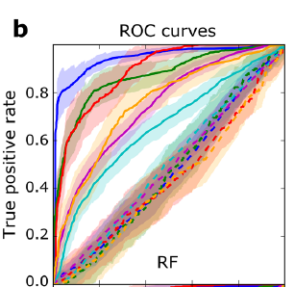
Whole-metagenome sequencing reveals effect sizes are different for different diseases
Pasolli et al - Machine Learning Meta-analysis of Large Metagenomic Datasets: Tools and Biological Insights– mbio, 2016

Slide 15
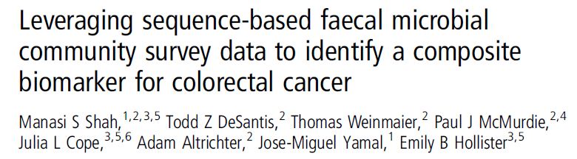
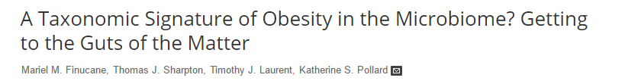
Reproducibility in metagenomics experiments appears to depend on effect sizes
There is a reproducible signal for colorectal cancer across datasets…
But not for obesity across datasets…
Sze and Schloss - Looking for a Signal in the Noise: Revisiting Obesity and the Microbiome– mbio, 2016

Slide 16
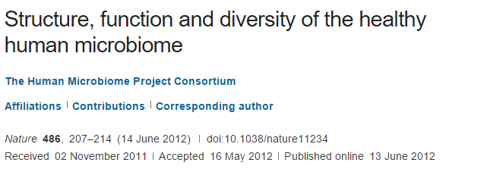
Effect sizes are often really, really small
“We conclude that most variation in the human microbiome is not well explained by … phenotypic metadata”

Slide 17
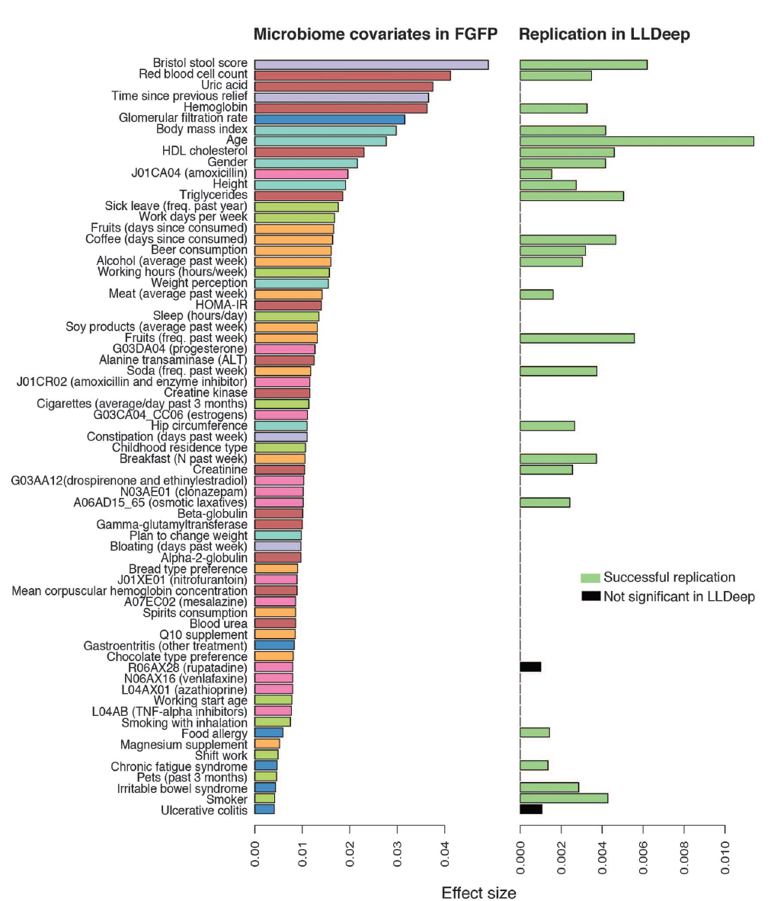
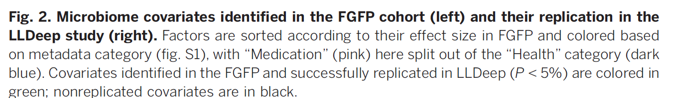
Microbial community composition and gene content is poorly associated with healthy variation
Initial analysis: 503 metadata variables
69 significant at 10% FDR
26 have analog in replication cohort
24 of these are significant
(but effect sizes in replicate cohort drop to << .01)
Power estimates suggests > 1600 subjects
needed to power BMI study…
2016
Falony et al. Population-level analysis of gut microbiome variation -Science 29 Apr 2016

Slide 18
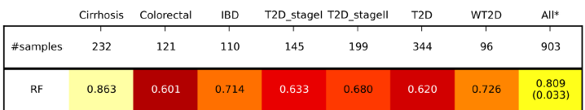
Remarkably, replicability is maintained across disease states
accuracy
With regards to a microbial signature defined by whole-metagenome sequencing….
All disease states (across studies) have common signal
All healthy states (across studies) have a common signal
Pasolli et al - Machine Learning Meta-analysis of Large Metagenomic Datasets: Tools and Biological Insights– mbio, 2016

Slide 19
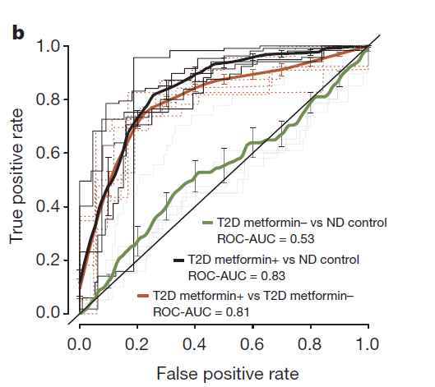
There is convincing evidence that associations with drug state are a
major component of metagenomic association studies
Forslund et al Disentangling type 2 diabetes and metformin treatment signatures in the human gut microbiota– Nature, 2015

Slide 20
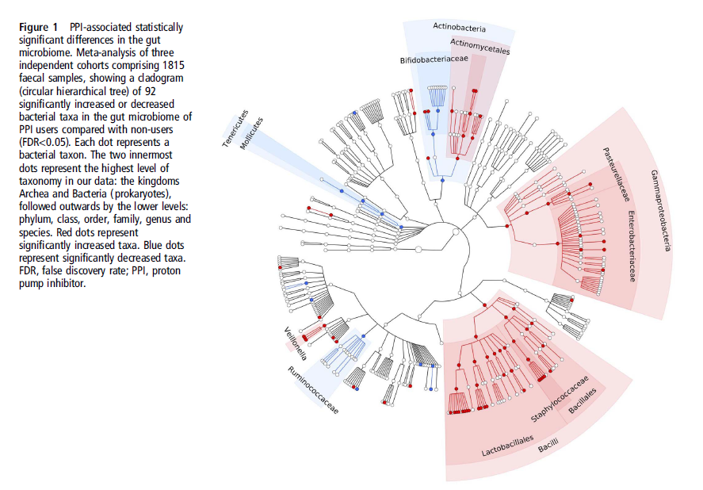
Proton pump inhibitors profoundly change the microbiome
Imhann et al–Proton pump inhibitors affect the gut microbiome Gut, 2015

Slide 21
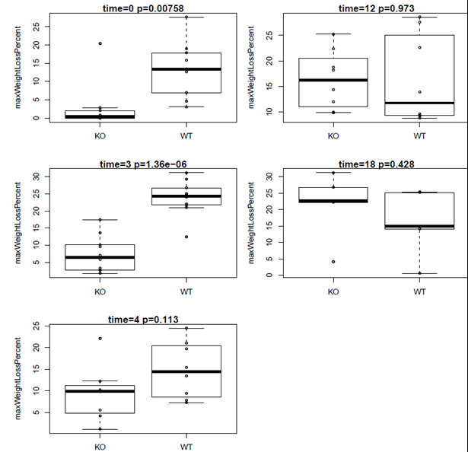
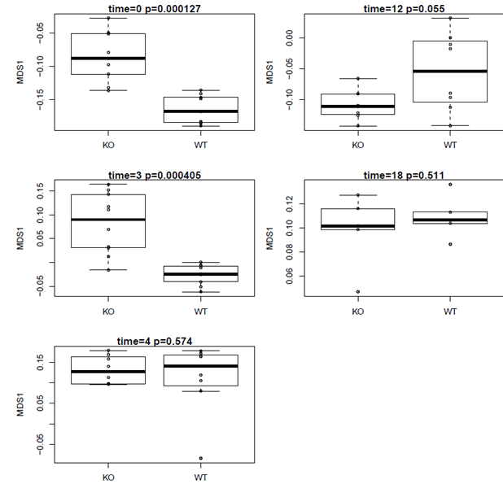
Stochasticity in animal experiments are major causes of biological variability
Unpublished data: Jonathan Hansen – UNC Chapel Hill
Notes:
in wild-type (WT) and Casp11-/- mice.

Slide 22
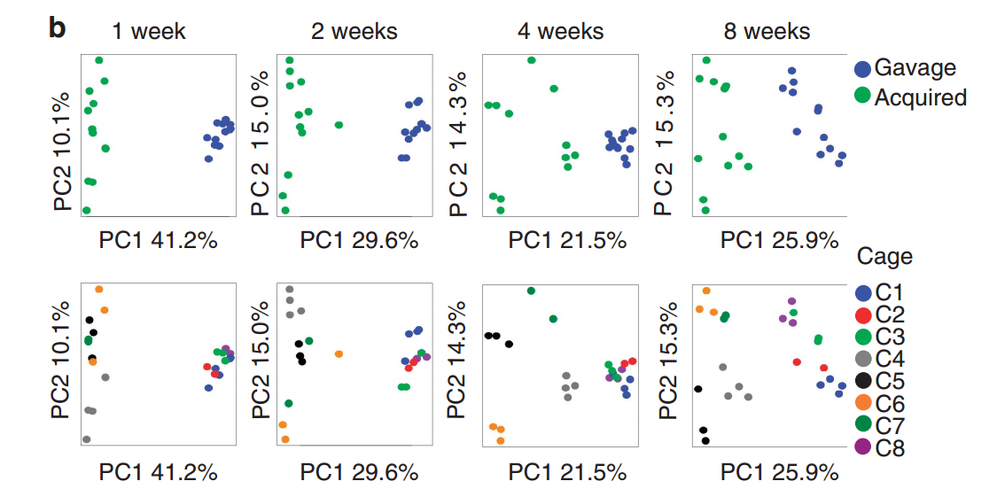
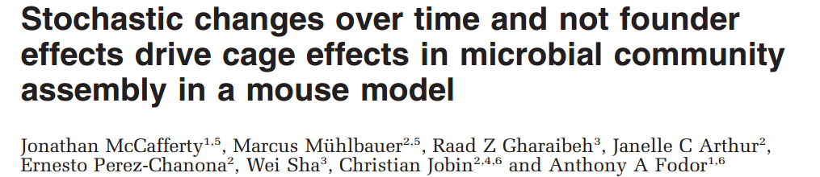
Mouse experiments take place in the context of a changing island ecology

Slide 23
Which choices matter most in metagenomics pipeline?

Slide 24
A metagenomics pipeline consists of many, sometimes difficult to justify, choices
Experimental design
Visualization and statistical analysis
Sample Size (# of cages not just # of mice)
Properly consented cohorts
Capture of confounding variables
Sufficient variation across space and time
Negative and Positive controls
Which diversity metrics?
Log-transform data?
Parametric or non-parametric tests?
Simple linear models?
Mixed models?
Zero-inflated models?
Negative-binomial based models?
Correction for multiple hypothesis testing?
Remove rare taxa?
Track sequencing depth as a confounder.
Track potential biological confounders
(e.g. cage in mouse experiments; drugs in
human surveys)
Supervised classification to build predictive
models? Cross-fold validation?
Random Forest classifiers?
Reproducibility across cohorts and datasets
generated by different labs?
Ordination?
Unifrac (weighted or un-weighted).
or PcOA? With what distance metric
(Bray-Curtis?)
Multi-page, multi-factorial visualizations?
DNA extraction
Which extraction kit/protocol?
Which sequencing platform?
Whole genome or 16S? If 16S, which primers?
sequencing
Merged paired ends? With what parameters?
Qual score filter? With what parameters?
Filter against database of known sequences? With what parameters?
Chimera check? Which algorithm? With what parameters?
Sufficient sequencing depth? Remove unique sequences?
Classification/clustering
Reference database or denovo OTUs? Or something in between?
Which algorithm (RDP, kraken, greengenes, uparse)?
What database? With what parameters?
Are the sequences microbial? From the expected tissue?
Are they just kit microbes?
Normalization
Simple proportions? Rarefication (with what depth?
single rarefication vs. average).
Balance trees? Ratio space? Geometric Mean based normalization?

Slide 25
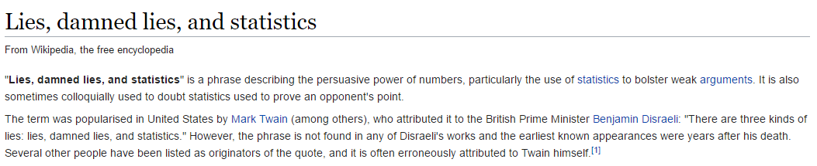
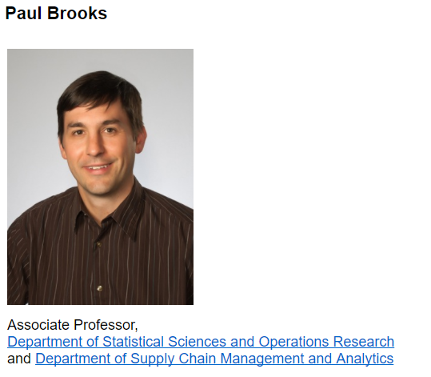
“If you can’t see it, it’s probably not real”
I encourage my students to spend as much or more time on visualization than modeling…
Languages such as R have extraordinary capacities for allowing detailed inspection of complex,
Multi-variate datasets…

Slide 26
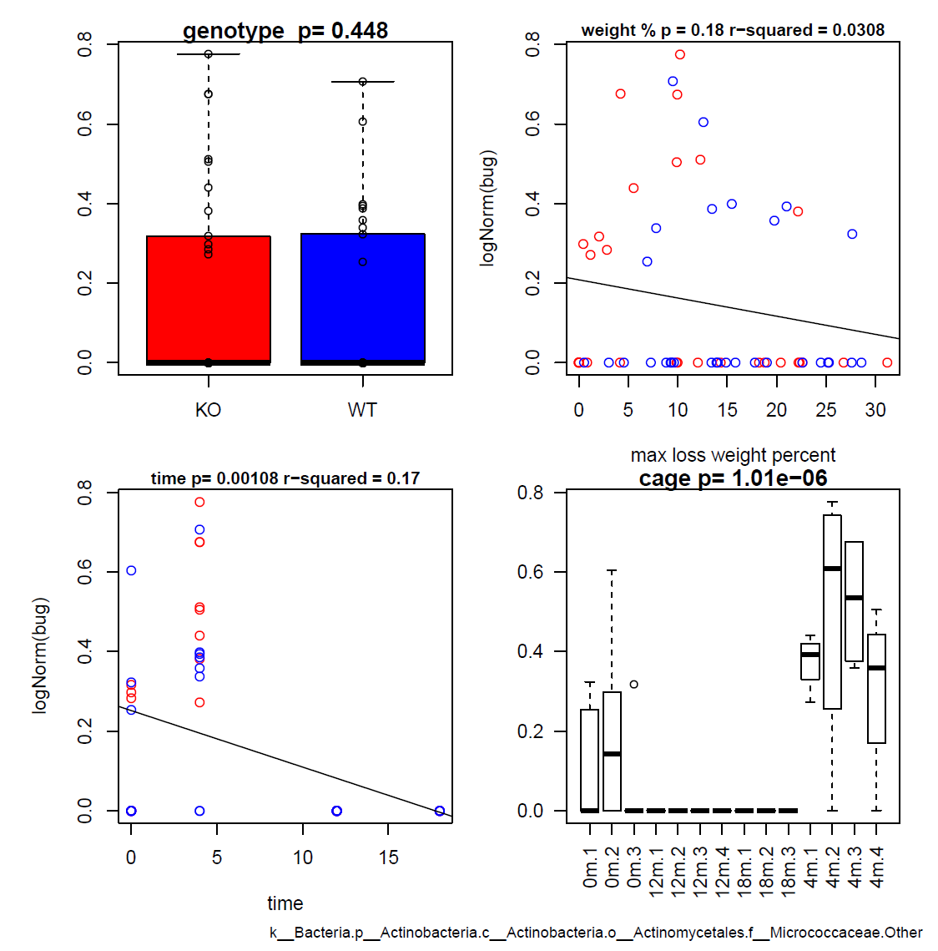

Slide 27
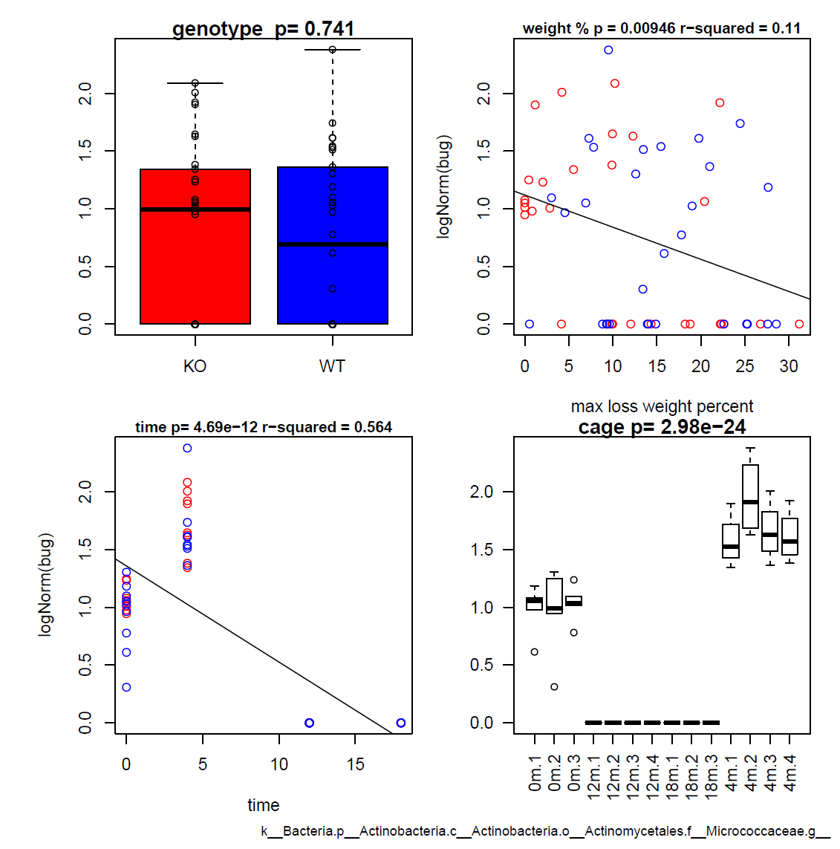

Slide 28
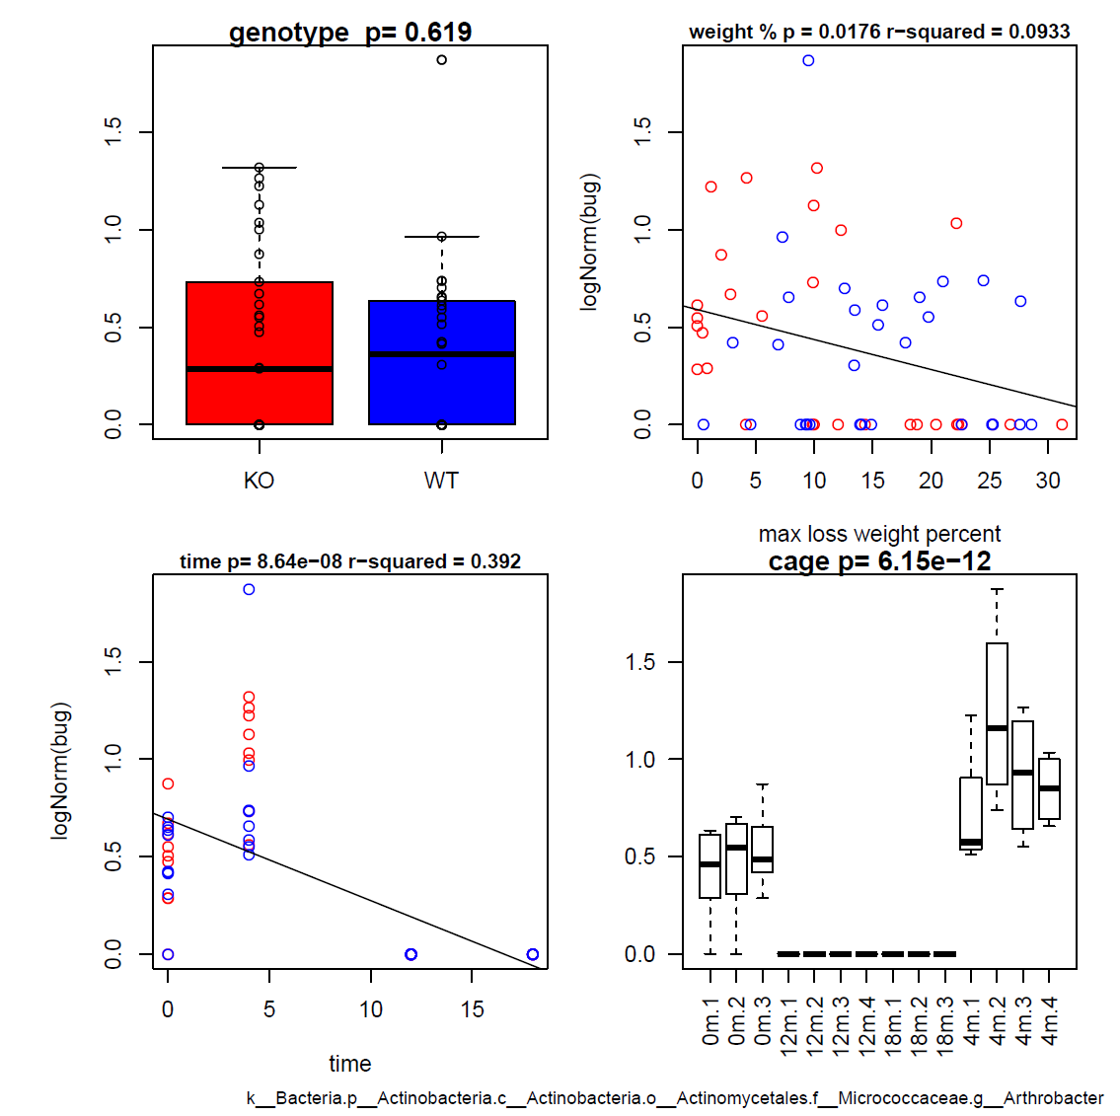

Slide 29
“Law is to justice as medicine is to immortality”….
As “genomics pipelines are to unbiased truth”
Our gold standard is reproducibility across studies..
Several recent meta-analyses have been surprisingly encouraging
in suggesting that for diseases with larger effect size, reproducibility is achievable
- community will need to pound on these results for awhile
- question of confounders is of central importance
Is there a single axis of dysbiosis across diseases?
If there is, is it caused by exposure to drugs?

Slide 30


Our lab is hiring:
Research Assistant Professor
Post-doctoral fellows
graduate students
Contact:
afodor@uncc.edu
Image: www.tierpoint.com

Slide 31
Consulting:
Salix Corporation
Second Genome

Slide 32
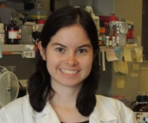











Acknowledgements
UNC-Chapel Hill
Janelle Arthur
Annie Green Howard
Marcus Muhlbauer
Penny Gordon-Larsen
Jonathan Hansen
UNC-Charlotte
Roshonda Barner
Ra’ad Gharaibeh
Jon McCafferty
Michael Sioda
Kathryn Winglee
UF- Gainesville
Christian Jobin
USC Vanderbilt University
Tanya L Alderete Martha J. Shrubsole
Michael Goran
Emily Noble
Scott Kanoski
Kathryn Winglee
Annie Green Howard
Penny Gordon-Larsen
Raad Gharaibeh
Jon McCafferty
Marcus Muhlbauer
Janelle Arthur
Christian Jobin

Slide 35
Inference performed on WGS and 16S can produce very similar results
Supplementary table 7

Slide 36
Agreement between 16S and WGS is related to expression level
Bacteroides
Correlation Coefficient
Unclassified
mean Log 10 ( average # of reads)
These are differences across sequencing and informatics (RDP vs. Kraken) pipelines

Slide 37
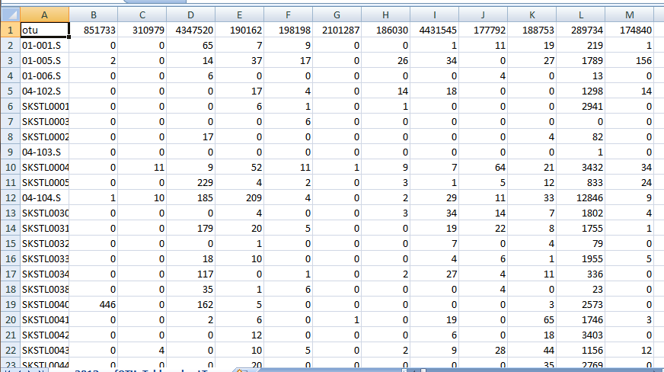
16S rRNA experiments are always compositional and often sparse
OTUs
S
A
M
P
L
E
S
Compositional – because different samples have different numbers of sequences
Sparse – because there are many zeros in the spreadsheet

Slide 38

Compositionality is a well-studied problem in statistics, but remains challenging

Slide 39
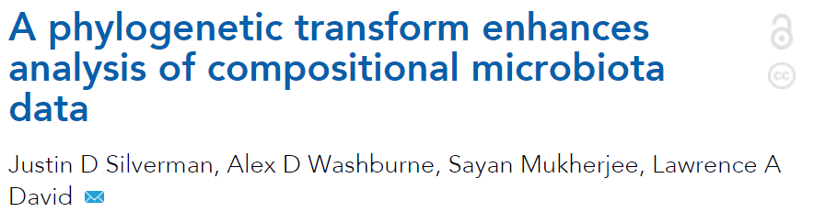
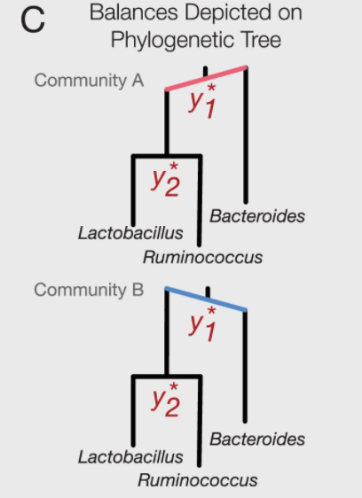
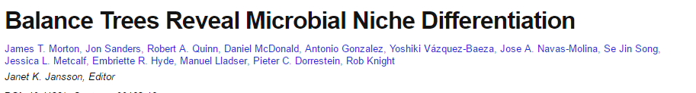
Recent papers have suggested combining phylogeny with normalization to explicitly address compositionality
This is a promising area of research…

Slide 40
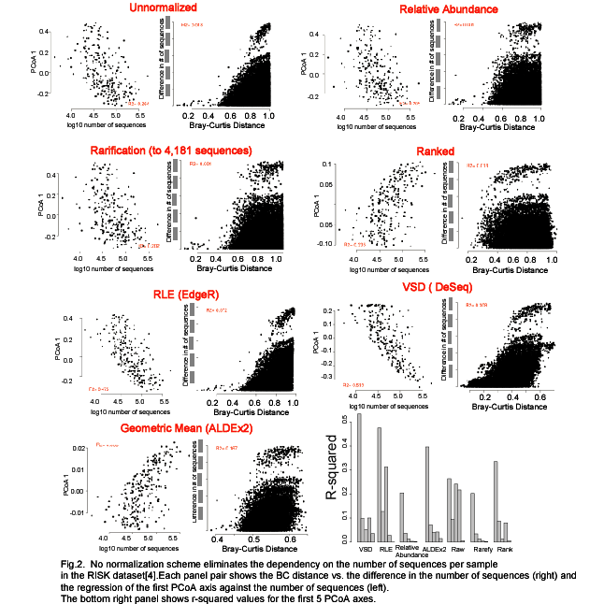
No normalization scheme eliminates the dependency of sequencing depth
Just as no one statistical test is appropriate for inference, there is likely no one normalization scheme that will be appropriate for all datasets.
Bioinformatics pipelines for 16S rRNA can explicitly track number of sequences per samples as a potential confounding variable

Slide 41
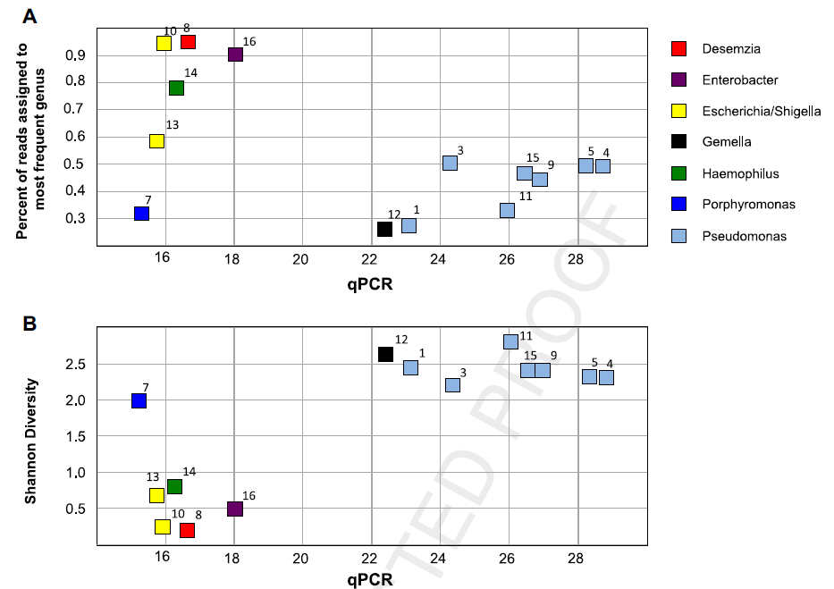
Low abundance samples are inherently challenging to survey
Less abundant
Hanna et al - Comparison of culture and molecular techniques for microbial community characterization
in infected necrotizing pancreatitis - J. Surgical Research - 2014

Slide 42
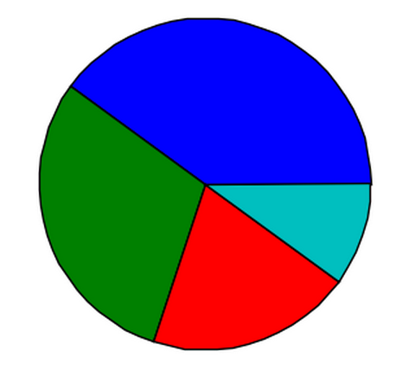

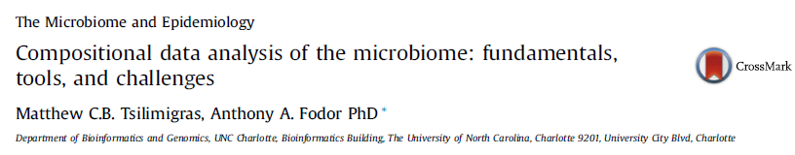
Can we fairly compare high and low biomass samples?
VS.

Slide 43
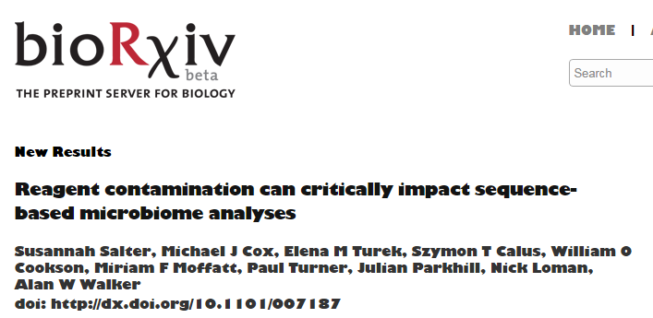
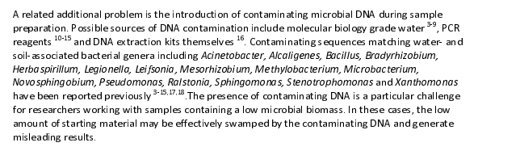
Clearly the sequencing of negative controls should be part of all of our pipelines..

Slide 44
A metagenomics pipeline consists of many, sometimes difficult to justify, choices
Experimental design
Visualization and statistical analysis
Sample Size (# of cages not just # of mice)
Properly consented cohorts
Capture of confounding variables
Sufficient variation across space and time
Negative and Positive controls
Which diversity metrics?
Log-transform data?
Parametric or non-parametric tests?
Simple linear models?
Mixed models?
Zero-inflated models?
Negative-binomial based models?
Correction for multiple hypothesis testing?
Remove rare taxa?
Track sequencing depth as a confounder.
Track potential biological confounders
(e.g. cage in mouse experiments; drugs in
human surveys)
Supervised classification to build predictive
models? Cross-fold validation?
Random Forest classifiers?
Reproducibility across cohorts and datasets
generated by different labs?
Ordination?
Unifrac (weighted or un-weighted).
or PcOA? With what distance metric
(Bray-Curtis?)
Multi-page, multi-factorial visualizations?
DNA extraction
Which extraction kit/protocol?
Which sequencing platform?
Whole genome or 16S? If 16S, which primers?
sequencing
Merged paired ends? With what parameters?
Qual score filter? With what parameters?
Filter against database of known sequences? With what parameters?
Chimera check? Which algorithm? With what parameters?
Sufficient sequencing depth? Remove unique sequences?
Classification/clustering
Reference database or denovo OTUs? Or something in between?
Which algorithm (RDP, kraken, greengenes, uparse)?
What database? With what parameters?
Are the sequences microbial? From the expected tissue?
Are they just kit microbes?
Normalization
Simple proportions? Rarefication (with what depth?
single rarefication vs. average).
Balance trees? Ratio space? Geometric Mean based normalization?

Slide 45
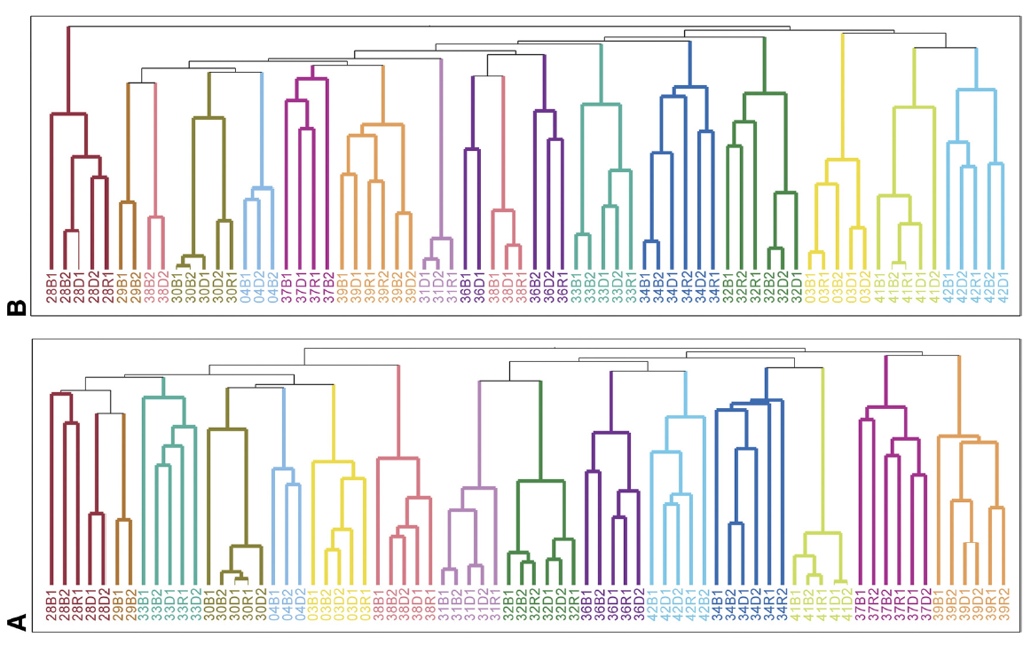
The signal seen in 16S sequences can be observed with other methods
Spencer et al, Association between composition of the human gastrointestinal microbiome and development of fatty liver with choline deficiency,2011

Slide 46
Assertion 2: Biological reproducibility is a central challenge
Drugs as confounding variables explains some, and possibly most, of reproducibility across studies
Animal experiments show surprising amounts of stochasticity

Slide 47
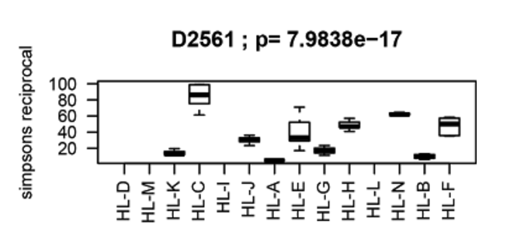


Does the lab which extracts a sample have a significant effect on Simpson’s diversity?
In general, yes. But for some samples, much more than others
null hypothesis of
no effect of Simpson’s
diversity by extraction
lab
Informatics pipelines interact with different extraction pipelines in different ways…
Notes:
Supplementary Figure 8: Individual samples show differences in how much diversity estimates are dependent on wet lab extraction. Each column represents one specimen, with the distribution of p-values across bioinformatics protocols (colors) testing whether handling lab has a significant effect on the estimation of Simpson diversity. For some samples (such as D2327), diversity estimates across different handling labs were not affected by bioinformatics protocol, while for others (such as D2561) different handling protocols produced very different absolute diversity measurements depending on bioinformatics protocol. In the case of D2561, a freeze-dried specimen, different extraction protocols produced unusually variable distributions of Bacteroidetes versus Firmicutes, and some extraction results included large proportions of likely contaminants such as Methylobacterium, Staphylococcus, and Spirochaetes. A smaller study only incorporating a few specimens or technical replicates using the same specimen might thus reach different conclusions based solely on which specimens happen to be included.

